Slide 1
MXD9976AT Application Note_
ES0 V0.1_UHB

Slide 2
Version Information
Version | History | Date
V0.1 | ES0 UHB First draft | 2025-10-12

Slide 3
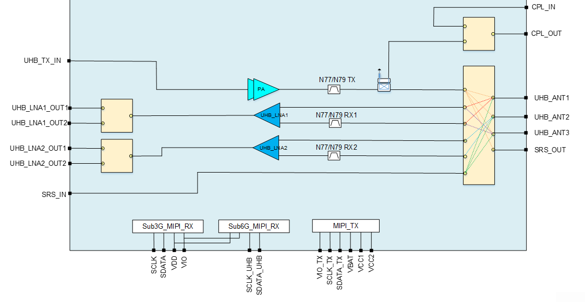
1.0 MXD9976AT Functional Block Diagram

Slide 4
1.1 MXD9976AT reference design

Slide 5
2.1 USID Define
MID/PID/USID
Reg addr | Reg Name | Data Bits | Description | Tx PA&ASM | Rx LNA
0x1D | PID | [7:0] | Product ID | 0xD8 | 0x31
0x1E | MID | [7:0] | Manufacture ID [7:0] | 0x81 | 0xAA
0x1F | MID | [7:4] | Manufacture ID [11:8] | 0x3 | 0x3
 | USID | [3:0] | USER ID | 0x9 | 0x4

Slide 6
2.2 TX Switch Mode
TX Channel Select (USID=0x9) @HPM & Config
Addr➔ | VCC/V | VBAT/V | 0x1C （Optional） | ANT select | PA Enable | PA Bias1 | PA Bias2 | PA Bias3
 |  |  |  | 0x00 | 0x05 | 0x06 | 0x07 | 0x08
TX-ANT1 | 3.8 | 3.8 | 0x38 | 0x11 | 0x21 | 0x1F | 0x1F | 0x30
TX-ANT2 | 3.8 | 3.8 | 0x38 | 0x12 | 0x21 | 0x1F | 0x1F | 0x30
TX-ANT3 | 3.8 | 3.8 | 0x38 | 0x14 | 0x21 | 0x1F | 0x1F | 0x30
TX-SRSOUT | 3.8 | 3.8 | 0x38 | 0x13 | 0x21 | 0x1F | 0x1F | 0x30

Slide 7
2.3 TX Switch Mode_SRSIN&CPL
ASM Channel Select (USID=0x9) @Config
Addr➔ | 0x1C （Optional） | ASM_CTRL2
 |  | 0x01
SRS_IN-ANT1 | 0x38 | 0x01
SRS_IN-ANT2 | 0x38 | 0x02
ASM Channel Select (USID=0x9) @Config
Addr➔ | 0x1C （Optional） | CPL_CTRL
 |  | 0x03
CPLIN-CPLOUT | 0x38 | 0x03

Slide 8
3.1 MXD9976AT RX Config
RX TEST Config
 | ASM USID=0x09 |  |  | RX USID=0x04
Addr➔ | 0x1C （Optional） | Ant select |  | 0x1C | 0x2D |  | LNA1 Enable | LNA1 Gain |  | LNA2 Enable | LNA2 Gain | LNA1 OUT SW Control |  | LNA2 OUT SW Control
 |  | 0x00 | 0x02 |  |  |  | 0x01 | 0x02 |  | 0x03 | 0x04 | 0x05 |  | 0x08
ANT1-LNA1_OUT1 | 0x38 | Reg00=21 | Reg02=00 | 0x38 | 0xFF |  | 0x00 | 0x00 |  | 0x0F | 0x21 | 0x01 |  | 0x00
ANT1-LNA1_OUT2 | 0x38 | Reg00=21 | Reg02=00 | 0x38 | 0xFF |  | 0x00 | 0x00 |  | 0x0F | 0x21 | 0x03 |  | 0x00
ANT2-LNA2_OUT1 | 0x38 | Reg00=00 | Reg02=02 | 0x38 | 0xFF |  | 0x0F | 0x21 |  | 0x00 | 0x00 | 0x00 |  | 0x03
ANT2-LNA2_OUT2 | 0x38 | Reg00=00 | Reg02=02 | 0x38 | 0xFF |  | 0x0F | 0x21 |  | 0x00 | 0x00 | 0x00 |  | 0x01

